Slide 1
Fitness for Life
Unit 2

Slide 2
Chapter 7

Slide 3
Aerobic vs. Anaerobic
Aerobic
Literally means with oxygen
Endurance type activities
Aerobic Activities:
Steady enough activity to allow your heart to supply enough oxygen to your muscles

Slide 4
Aerobic vs. Anaerobic
Anaerobic
Literally means without oxygen
Sprint type activities
Anaerobic Activities
Activity that is so intense that your body cannot supply adequate oxygen to sustain it for long periods of time. For this reason it is typically done in short bursts.

Slide 5
Cardiovascular vs. Respiratory
Cardiovascular system
The body system that includes your heart, blood vessels and the blood.
Respiratory system
The body system that includes your lungs and air passages.
Vessels
Three types
Veins: carry blood to the heart
Arteries: carry the blood to the body away from the heart
Capillaries: smallest part of the vessels and transition the blood from the arteries to the veins

Slide 6
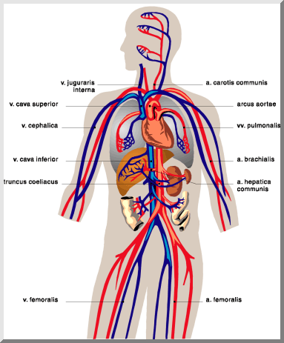

Slide 7
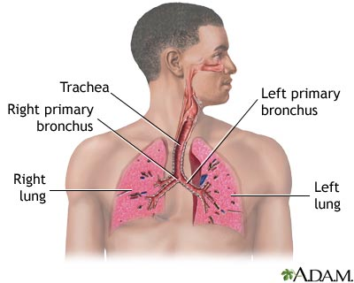

Slide 8
Cardiovascular Fitness
Explain how cardiovascular fitness helps your cardiovascular system work more efficiently and helps prevent cardiovascular diseases.
Good aerobic fitness strengthens the heart, allowing it to pump more blood per beat; blood vessels remain healthy; and together, these factors reduce the risk of heart diseases.
Why should you do more than one self-assessment for determining cardiovascular fitness?
You may not be good at one type of fitness test (aerobic running) but may be good at walking, swimming and biking.

Slide 9
Cardiovascular Fitness
Why is it important to monitor your heart rate to make sure it is in the target heart rate zone?
Because if you below or above the heart rate zone, your exercise session may not improve aerobic fitness.

Slide 10
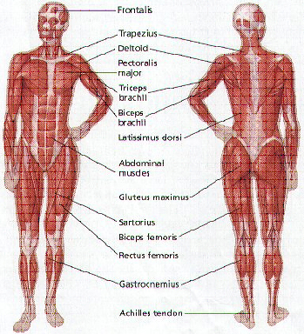
MUSCULAR SYSTEM

Slide 11
Cholesterol
Cholesterol:
a fatlike substance found in meats, dairy and egg yolks.
Lipoproteins:
Carriers of cholesterol in the blood

Slide 12
Cholesterol
Two types of lipoproteins
LDL
Low-density lipoproteins: bad cholesterol; stay in the body and can cause atherosclerosis
HDL
High-density lipoproteins: good cholesterol; help prevent atherosclerosis by carrying excess LDLs out of the body.

Slide 13
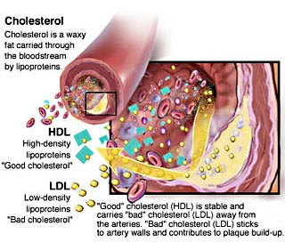

Slide 14
Cholesterol
Why can cholesterol be dangerous to your health?
High levels of LDLs can cause atherosclerosis and heart disease
What types of food have good/bad types of cholesterol?
Bad: fried, fatty foods (high levels of LDLs)
Good: grains, omega 3 fatty-acids, nuts

Slide 15
Chapter 8

Slide 16
Active Aerobics
Active Aerobics:
Activities that are vigorous enough to bring your heart rate into the target zone.
Aerobic:
Means “with oxygen”
Why would active aerobics be one of the most beneficial types of activity?
It directly enhances and improves your cardiovascular system
Circuit Training:
Performing several different activities one after another during a workout

Slide 17
Active Aerobics
Examples of Active Aerobics:
Running
Biking
Swimming
Skating
P90X
TaeBo
Any activity that is going to elevate your heart rate into the target zone.

Slide 18
7 Biomechanical Principles of Jogging
7 Biomechanical Principles of Jogging:
1. Use foot action appropriate for jogging
2. Swing your legs and feet straight forward
3. Swing your arms straight forward and backward
4. Keep your trunk straight up and down
5. Learn your own best pace
6. Avoid running on hard surfaces
7. Breathe easily

Slide 19
Active Recreation
Active Recreation:
Activities that are fun and typically non-competitive and are not meant for fitness, but can enhance one’s level of fitness.
Examples:
Backpacking
Hiking
Rock climbing

Slide 20
Active Aerobics vs. Active Recreation
What are some good safety tips for performing active aerobics and active recreation?
Wear proper safety equipment
Use safe equipment
Get proper instruction
Perform within the limits of your current skills
Plan ahead

Slide 21
Active Aerobics vs. Active Recreation
Why is it important to include in your activity plan, choices from the active aerobics and active recreation part of the Physical Activity Pyramid?
For variety – active recreation can be done as lifestyle activities, whereas aerobic exercise can be more vigorous and structured.

Slide 22
Leisure Time & Recreational Activity
Leisure time:
Time free from work, school, homework and jobs
Recreational activity:
Activity done during leisure time to refresh and rejuvenate you.
Examples:
Video games
Watching movies
Facebook
Etc…

Slide 23
Boys vs. Girls
According the statistics, 72% of boys and 52% of girls are vigorously active 3x a week. Why do you think girls are lower than boys? What suggestions do you have that might help change these statistics?
More boys are involved in varsity sports than girls and their practices would be considered vigorous activity. Additionally boys are more likely to go out and play sports with their friends than girls.

Slide 24
Chapter 9

Slide 25
Sports and Fitness
Sports
Individual sports:
Sports that you can participate in by yourself
Examples:
Running
Swimming
Biking
Bowling
XC Skiing
Skiing/Snowboarding

Slide 26
Sports and Fitness
Sports
Lifetime and recreational sports:
Sports that can be done when you grow older
Examples:
Running
Swimming
Biking
Golf
Bowling
Team sports
What do you think the largest age group to play team sports is?
Children & Teenagers

Slide 27
Sports and Fitness
Sports
3 guidelines for choosing sports:
1. Sport you enjoy
2. A sport you may have success at
3. A sport that friends are involved in
Why is it important to be physically fit when participating in sports?
Fitness can improve sport performance and decrease the chance of injury

Slide 28
Sports and Fitness
What sports are examples for developing each of the 5 parts of health-related fitness?
CV Fitness/Body Fatness:
Cross Country and Track & Field
Strength:
Football, wrestling
Muscular Endurance:
Basketball
Flexibility:
Dance, gymnastics

Slide 29
Skill and Sports
6 parts of skill-related fitness
1. Agility: ability to change the position of your body quickly and to control your body’s movements
2. Balance: ability to keep an upright posture while standing still or moving
3. Coordination: ability to use your senses together with your body parts or use two or more body parts together
4. Power: ability to use strength quickly
5. Reaction Time: amount of time it takes to move once you realize you need to act
6. Speed: ability to perform a movement or cover a distance in a short period of time

Slide 30
Skill and Sports
What is the difference between skill and skill-related physical fitness?
Skill-related fitness is fitness related to how well a skill can be performed; a skill is a talent you possess.
What are some ways to self-asses your skill-related fitness?
Doing tests of agility, balance and power

