Slide 1
The Teenage Drinking Brain

Slide 2
Types of Drinking
Ritual drinking—religious, traditional, etc
Social drinking—only with others
Alcoholism—2 or more drinks daily
Solo drinking—drinking alone
Binge drinking—4/5 drinks
Most deadly type
What is the typical teenage drinking style?

Slide 3
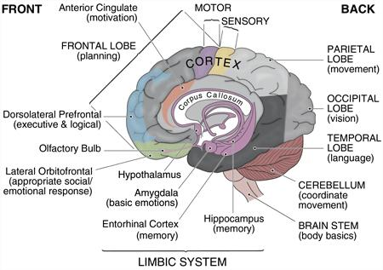
Alcohol affects a teen brain differently than a mature adult brain. The brain goes through rapid development and “wiring” changes during the ages of 12 and early 20s.
Areas of the brain that are effected by teenage drinking…
Prefrontal Cortex: Responsible for planning, decision making, good judgment and impulse control
*Undergoes the most changes during adolescence.
Hippocampus: Involved in memory and learning.

Slide 4
Alcohol, which acts as a depressant, slows down brain activity and hinders development.
Is alcohol considered a drug?
OF COURSE! It is Ethanol.

Slide 5
ALCOHOL AND JUDGEMENT- The teenage brain is still developing. Alcohol can impair the parts of the brain that control the following…
Motor Coordination: The ability to talk, drive, and process information
Impulse Control: Drinking lowers inhibitions and increases the chances that a person will do something they will regret when they are sober.
Memory: Impaired recollection and even blackouts can occur when too much alcohol has been consumed.
Judgment and decision-making capacity: Drinking may lead young people to engage in risky behaviors; including getting into a car with someone who has been drinking. These behaviors result in illness, injury, and even death.

Slide 6
More effects… Not just on the brain…
Violence: Children who start drinking before age 15 are 12 times more likely to be injured while under the influence of alcohol and 10 times more likely to be in a fight after drinking, compared with those who wait to drink until they are 21.
School Failure: Teens who use alcohol have higher rates of academic problems and poor performance than non drinkers.
Promiscuity: Alochol use by teens is a strong predictor of unprotected sexual activity and unwanted sexual advances.

Slide 7
More effects… Not just on the brain…
Illicit drug use: More than 67 percent of young people who start drinking before the age of 15 will try an illicit drug. Children who drink are 7.5 times more likely to use an illicit drug, more than 22 times likely to use marijuana and 50 times more likely to use cocaine than children who never drink.
Nutrition: Alcohol has calories, but has no nutritional value.
Alcohol does not have to be digested; approx. 20% of the alcohol is absorbed into the blood from the stomach, while the other 80% is absorbed in the small intestines. After absorption, alcohol is found in all body tissues, organs, and secretions.

Slide 8
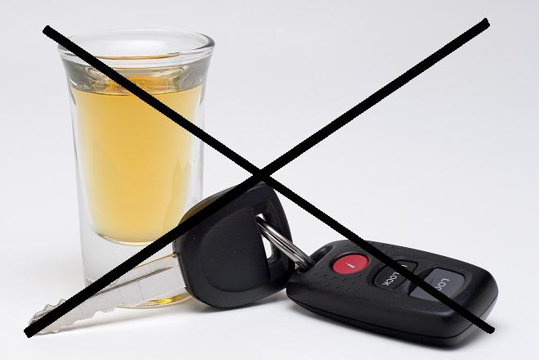
FACT: 45% of all traffic deaths are caused by alcohol

Slide 9
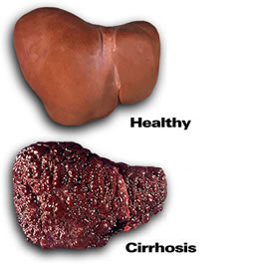
Alcohol Metabolism
Liver can metabolize about 1 drink every hour.
Does the typical teenage drinking style have 1 drink every hour? Probably not.

Slide 10
Designated Driver
A clever way to make more money AND seem like you’re fixing the drunk driving problem

Slide 11
FACT: Alcohol kills 650% more teenagers than all other drugs combined. Hmmm…… Maybe another reason why it is illegal for teenagers to drink.

Slide 12
With a partner, make a list of long term consequences that could happen to a teenager who decides to start drinking?

Slide 13
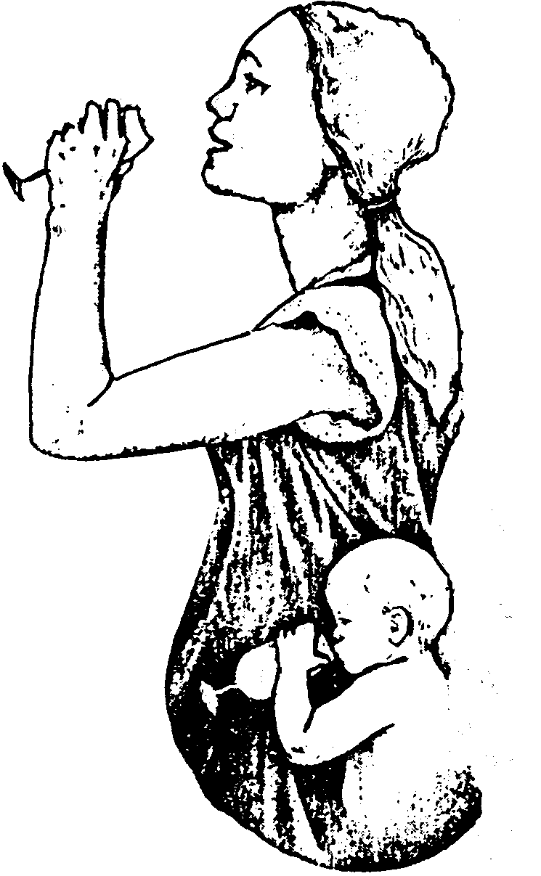
Fetal alcohol syndrome (FAS) is a condition that results from alcohol exposure during pregnancy.
Problems that may be caused by FAS are:
physical deformities,
mental retardation,
learning disorders,
vision difficulties,
and behavioral problems.
The problems caused by fetal alcohol syndrome vary from child to child, but defects caused by fetal alcohol syndrome are irreversible.
There is no amount of alcohol that's known to be safe to consume during pregnancy.

Slide 14
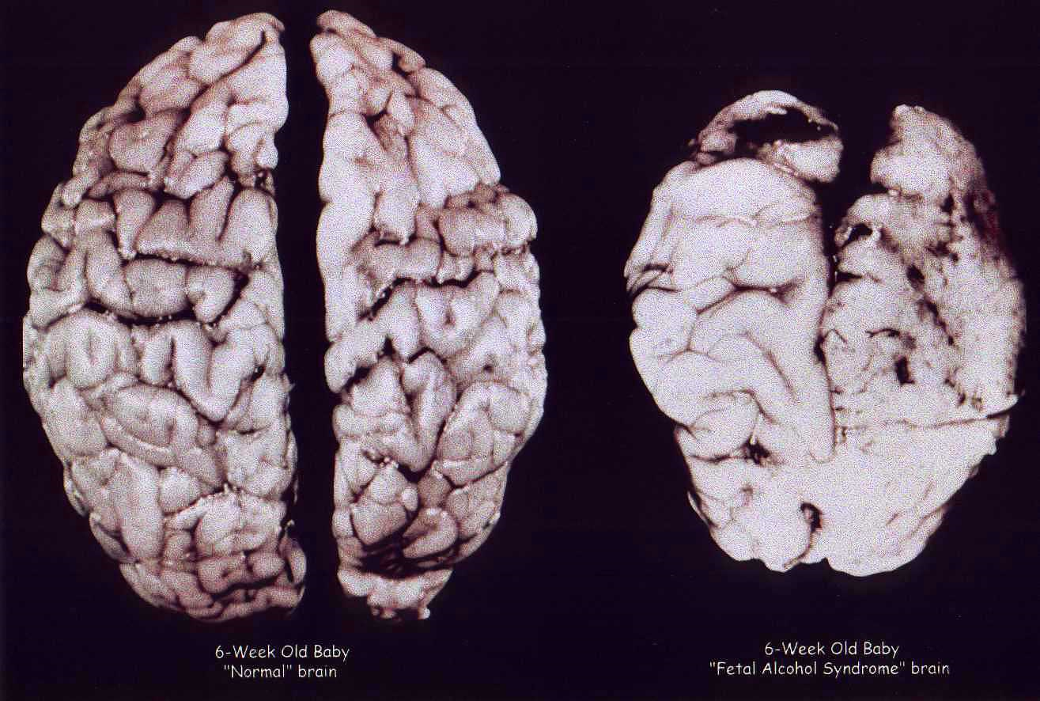

Slide 15
Why do you choose not to drink alcohol?

