Slide 1
RESILIENCY
–noun
1.the power or ability to return to the original form, position, etc., after being bent, compressed, or stretched; elasticity.
2.ability to recover readily from illness, depression, adversity, or the like; buoyancy
Notes:
1
Complete basketball demonstration. Have one ball that is inflated properly and the other is flat. Bounce both and ask the students why one bounced better than the other… what’s inside counts!

Slide 2
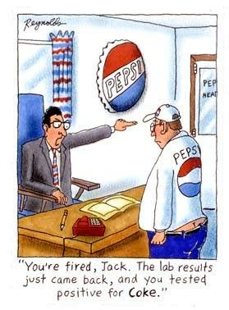
Events that can trigger stress
Major loss
Suspended from school
Something embarrassing happens
Illness
Arrested
Pregnancy
End of a relationship
Fired

Slide 3
Warning Signs
Depression
Feelings of hopelessness and worthlessness
Talk about death
Loss of energy and interest
Diminished ability to concentrate
Previous attempts
Recent victim of violence
Change in sleep patterns
Gives away articles they value
Increase use of drugs/alcohol
Withdraws from friends

Slide 4
A check-up from the neck up
"Am I depending on other people or situations to bring me happiness?”
Notes:
If I am not needed by anyone, or if I do not have a project or if my boy/gir friend breaks up with me.....or if my parents yell at me......this is my life for me to live......everybody else parents and teachers included have the opportunity to live their lives.....what am I going to do with mine......my life....my body.....my mind.....my talents.....my goals

Slide 5
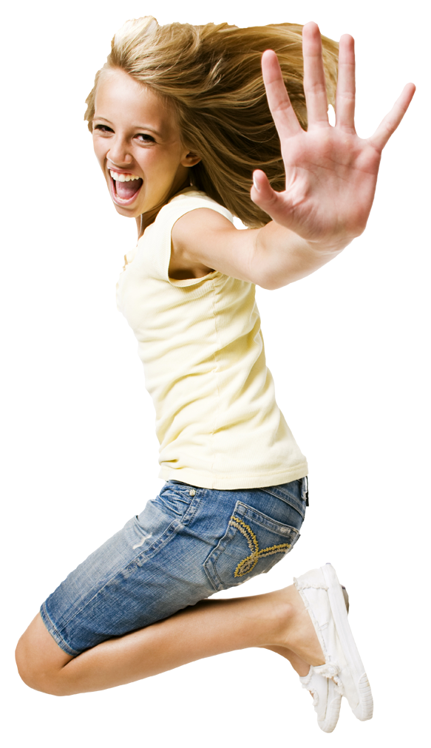
“Most people are searching for happiness outside of themselves. That’s a mistake. Happiness is something that you are and it comes from the way that you think.”
Notes:
The truth is that life is inconsistent and not fair. You can’t control other people and their action and you can’t always control the events that happen. However, you can control your reaction to them and that requires you to have a reserve of strategies to cope with life when it gives you lemons.

Slide 6
Resilient People
Overcome adversity,
Bounce back from setbacks,
Thrive under extreme, on-going pressure without acting in dysfunctional or harmful ways.
The most resilient people recover from traumatic experiences stronger, better, and wiser.
Notes:
Show Breakaway video.

Slide 7
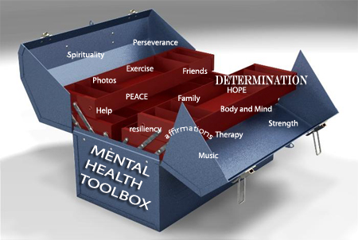
What can I do to be more resilient?
There are
10 ways to build resiliency
Notes:
Much like a toolbox, we want to give you 10 specific tools that will build-up the resiliency in you.

Slide 8
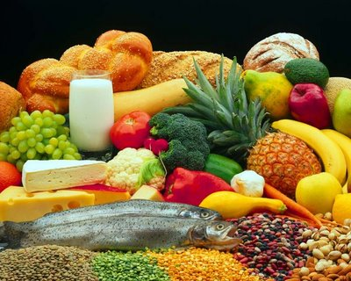
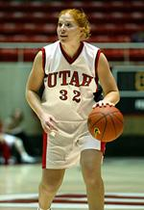
#1 Have a healthy lifestyle.
Eat three healthy meals a day, plus healthy snacks.
Exercise daily.
Get enough sleep.
Make time for relaxation every day.

Slide 9
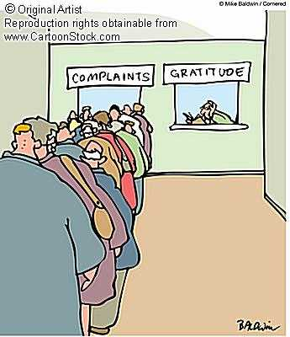
#2 Keep a gratitude journal
This gets you in a habit of accentuating the positive.
Daily entries will help you keep a positive frame of mind.

Slide 10
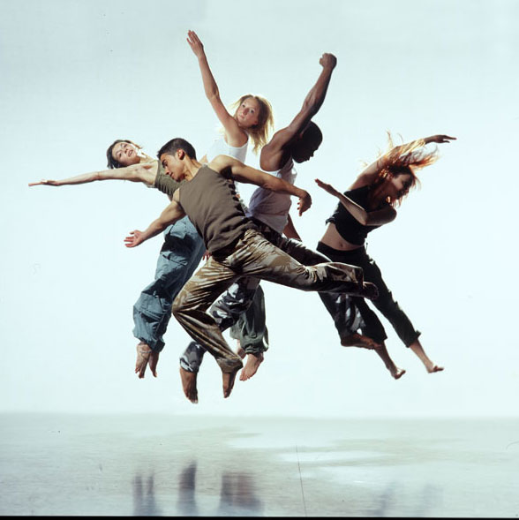
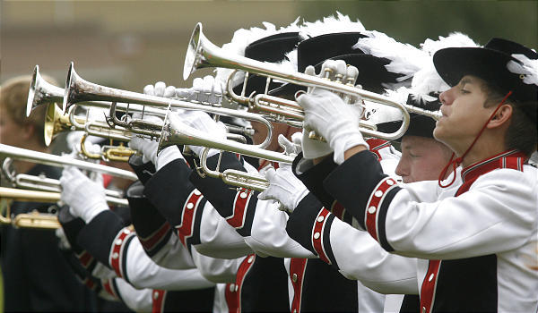
#3 Do something enjoyable and creative every day!
This reduces stress.
It helps you celebrate your strengths.
This builds self-esteem.
Creativity is the key to joy-
this is scientifically proven.
Notes:
Show clip from Napoleon Dynamite- when he is learning to dance in his room.

Slide 11
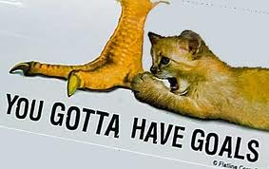
#4 Make positive goals and work towards them.
Making and attaining goals creates self esteem.
Making and attaining goals gives a purpose in life.

Slide 12
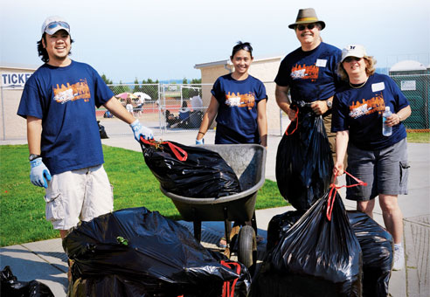
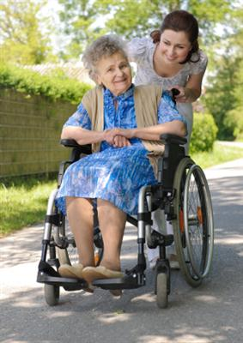
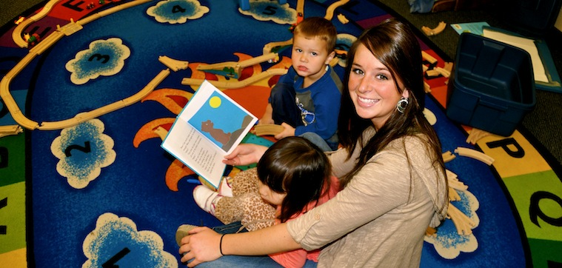
#5 Do something for someone else.
Giving of yourself creates feelings of worth and value.
Helping others provides purpose.

Slide 13
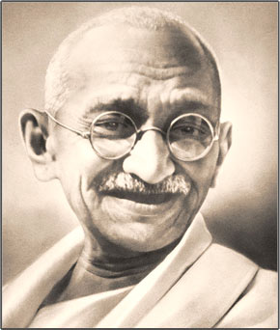
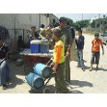
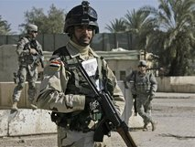
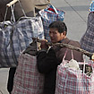
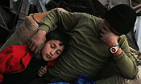
“Be the change you want in the world.” - Ghandi

Slide 14
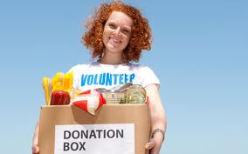
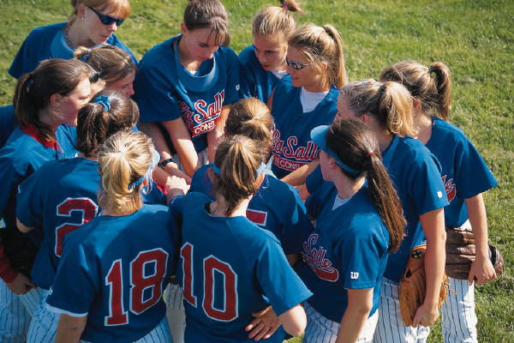
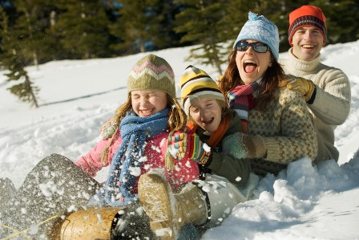
#6 Pick yourself up and get involved.
Take the initiative because it is up to you to bounce back.
Sitting around feeling sorry for yourself will get you nowhere- literally!

Slide 15
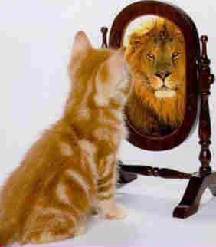
#7 Be positive!
Be aware of negative thinking and quit it!
Fill your mind with positive thoughts.
Surround yourself with positive people.
Turn life’s negative into life’s positives- find the
silver lining.
Notes:
Show the Jessica video

Slide 16
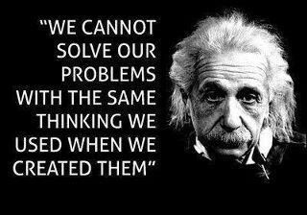
“Wisdom is avoiding all thoughts that weaken you and embracing those that strengthen you.”

Slide 17
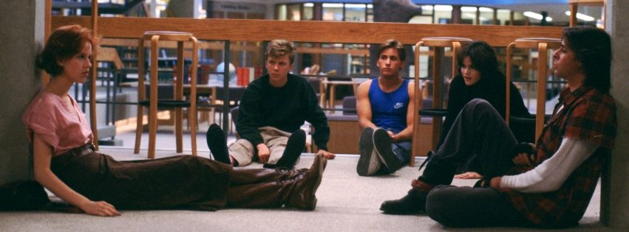
#8 Talk to others.
When you are stressed or overwhelmed, talk to others: family, friends, teachers, counselors.
Talking helps you to vent frustrations thus allowing the clouds to move on by.

Slide 18
#9 Be your own best friend.
Give yourself a break by being realistic.
Celebrate what you have accomplished.
Instead of dwelling on past mistakes, learn from the past and move on.

Slide 19
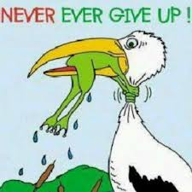
“Our greatest glory is not in never falling, but in rising every time we fall.”
- Confucius
Notes:
Show video clip of inspirational speaker who has no arms or legs.

Slide 20
#10 Develop Problem Solving Strategies
Prioritize what needs your urgent attention.
Recognize the potential of available resources.
Come up with a reasonable plan by asking what is your next, best step.
Notes:
Have students get in groups of 4-5 people and complete the survival activity.

Slide 21
“Grant me the serenity to accept the things I cannot change, the courage to change the things I can, and the wisdom to know the difference.”
- Reinhold Niebuhr
Notes:
Show the video of Nick Vujicic

