Slide 1
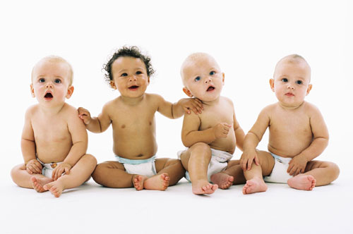
Where do babies come from?

Slide 2
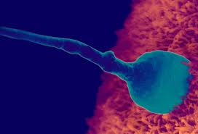
What is Conception?
When Sperm and Egg meet and fertilization occur

Slide 3
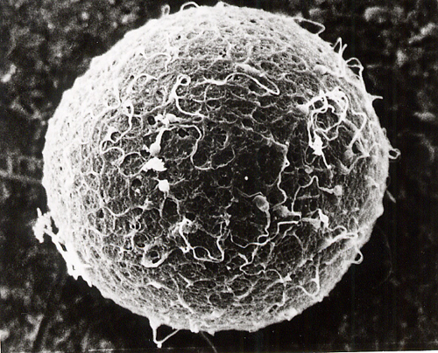
What is the Egg?
The women Sex cell that carries 23 chromosomes

Slide 4
What is the Egg?
Women are born with eggs.
One is brought to maturity each month. This will be about 400 eggs during her lifetime.
The egg is the largest cell in the female body.
On day 14 it is released and swept by (and in to) the Fallopian Tubes.
If sperm are present the egg may be fertilized.
If it is, it will take 5 to 6 days to enter the uterus.

Slide 5
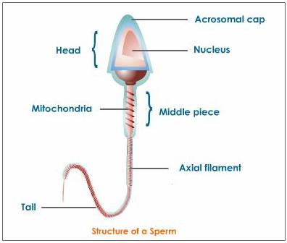
What is Sperm?
The Males Sex cell which contains 23 chromosomes

Slide 6
What is Sperm?
The sperm are the smallest cell in the male body.
Produced every day of a man’s life once he reaches puberty.
They can be stored in the epididymis for up to 6 weeks.
A typical ejaculation is between 100 to 500 million sperm.

Slide 7
FEMALE= Always carries the X chromosome.
MALE = May carry either the X or Y chromosome.
*Man is in charge of gender of baby ☺

Slide 8
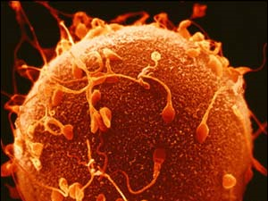
Capacitation
3-4 dozen sperm cluster around the egg and secrete an enzyme to dissolve the outer layer.
Only ONE sperm enters.
The egg then releases an electrical block on its surface to prevent any other sperm from entering.

Slide 9
Fertilization
Begins- When the sperm penetrates the egg surface.
Ends- Genetic material of the head of the sperm hits the center of the egg.

Slide 10
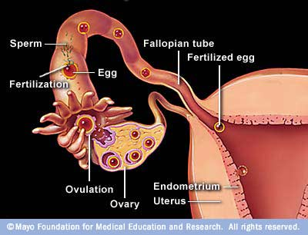
Where does the egg and sperm meet?
The sperm and egg meet in the fallopian tubes
After fertilization they travel down and attach to the uterus lining

Slide 11
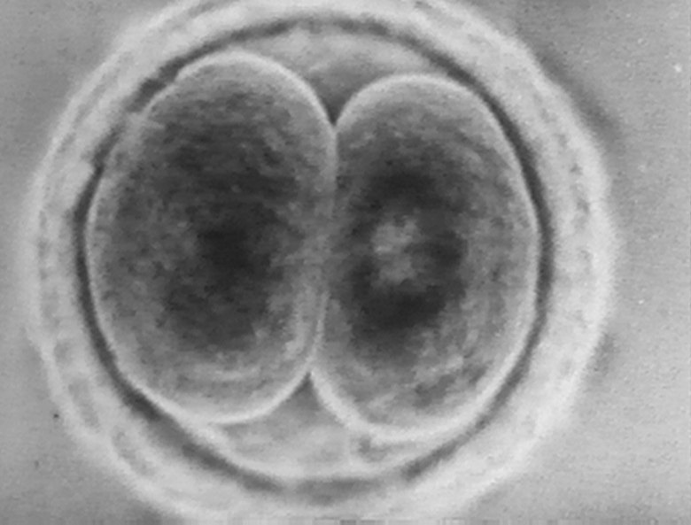
Zygote
A fertilized egg is first called a zygote. The zygote divides to form two cells about 24 hours after fertilization
Then the cells divide and multiplies again, forming more cells

Slide 12
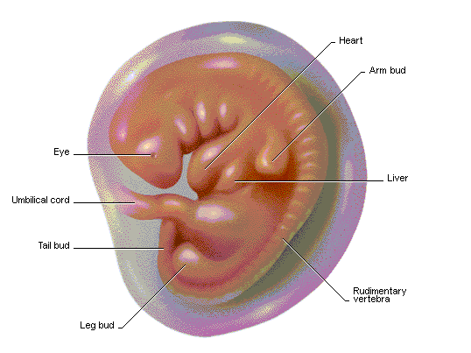
Embryo
After about a week, the zygote attaches itself to the lining of the uterus
After another week the zygote is called an embryo
This is the developing organism from two weeks until the end of the eights week of development

Slide 13
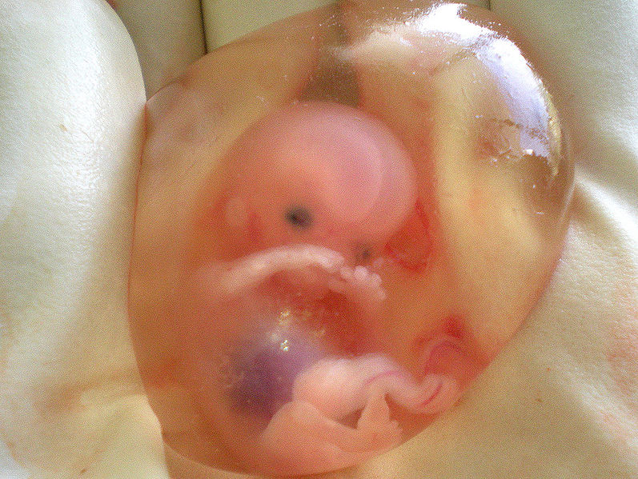
Fetus
After the eighth week the human embryo is called a fetus.
It is the developing organism from the end of the eighth week until birth (nine months)

Slide 14
Full term pregnancy-: 40 weeks
Age of viability: 20-21 weeks
survival outside the womb becomes possible for some fetuses.
Average weight gain during pregnancy: 25-35 lbs
Overweight vs. underweight

