Slide 1

WRITING PROMPT
What are some steps you could take to make your home a safer place to live? What are some steps you can take to be safe when you are out in the community?
Notes:
Writing Prompt

Slide 2

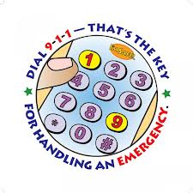
Personal Safety
The steps you take to prevent yourself from becoming the victim of a crime, tragedy, or accident

Slide 3
SHOW safety Clip…
Notes:
Netflix The Office Video: Season 5 epidsode 14
Play start to intro song!

Slide 4
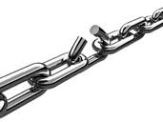
Accident Chain- Yellow book
Sequence of events that lead to unintentional injury
  Unsafe Situation- you over sleep and are in a rush to get ready for school
  Unsafe Habit- you left books on the stairs
  Unsafe Action- you hurry down the stairs
  The Accident- you trip over your books and fall down the stairs
  The Consequences- you break your arm when you land, have to go to the doctor, and are even later for school
Breaking any of the links in the chain will prevent the accident and any injury
Notes:
The accident chain page 731 in yellow book

Slide 5

At Home
Fire Prevention
  Smoke alarms
  Fire extinguishers
Electrical Safety
  Avoid overloading the system
  Inspect cords regularly
  Never use electronics in or near water
Notes:
Read in yellow book

Slide 6

At Home
Preventing Falls
  Keep stairs well lit with sturdy hand rails
  Use non-skid mats in bathrooms
  Keep floors dry and free from clutter

Slide 7

At Home
Poisons
  Store products safely
  Pay attention to labels
  Don’t mix chemicals

Slide 8
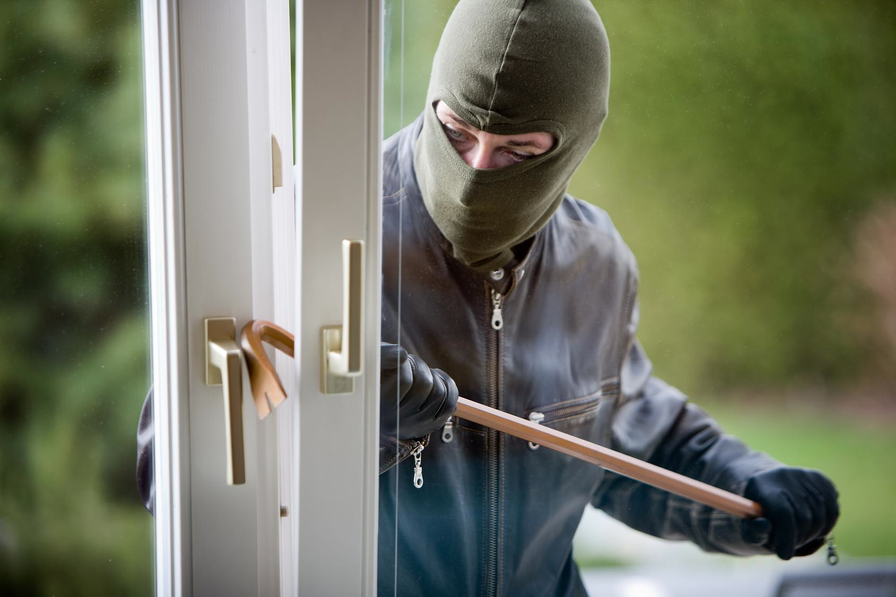
At Home
Guarding against intruders
  Keep doors and windows locked
  Identify people before opening the door
  Don’t let mail or newspapers pile up
  HAVE A FAMILY EMERGENCY PLAN

Slide 9
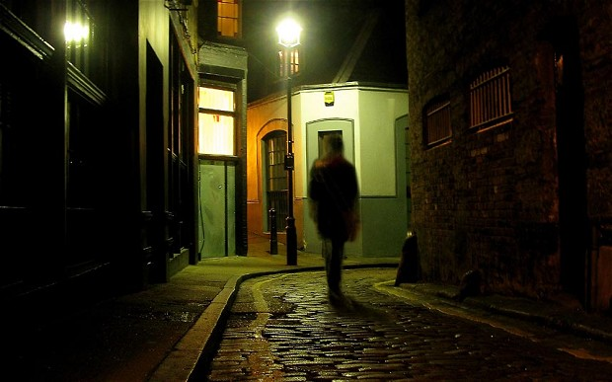
In the Community
Always be aware of your surroundings
Carry your cell phone in an easily accessible place
Avoid walking alone at night or in isolated areas
Walk briskly and confidently
Carry your wallet or purse in a way that makes it difficult to grab
Always park your car in a well lit area and lock it
Never hitchhike or give rides to people you don’t know well
Know the locations of public places where you can go if you need help
Let someone know where you are going and when you expect to be back
Notes:
If walking alone at night walk
Call somone
Carry your belongings where it would be difficult to grab

Slide 10

Outdoors
Know your limits
Bring supplies
Plan for weather
Wear appropriate clothing
Tell people your plans or go with a group
Be careful with fires
Pack it in, Pack it out- trash
Stick to the trails
Water safety
  Wear your life jacket
  Have an experienced person handling the boat

Slide 11
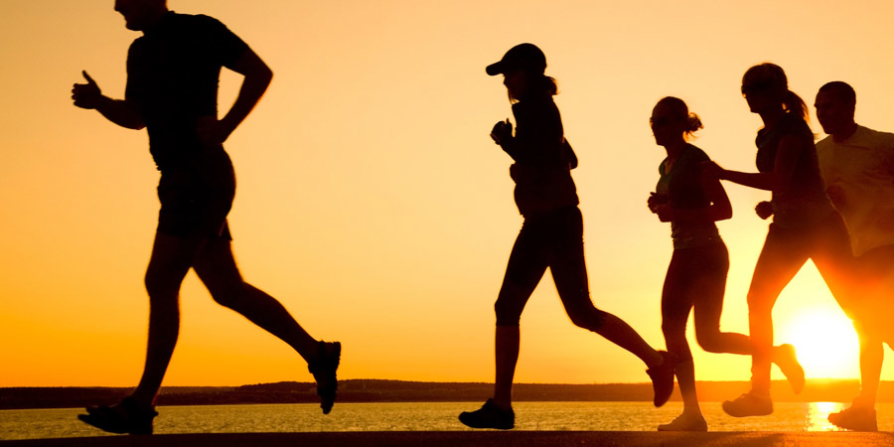
During Exercise
Use correct equipment
Dress appropriately
Bicycle safety
  ALWAYS wear your helmet
  Follow the rules of the road
  Use your hand signals
  Wear bright colors
Skating safety
  Wear your safety gear: helmet, elbow & knee pads, wrist guards
  Watch for pedestrians and motor vehicles

Slide 12

Online
Internet is forever
Keep your identity private
Keep online relationships online
Don’t respond to inappropriate messages
Let your parents know about the people you meet online, just like you would tell them about people you meet in the real world
Don’t post pictures or information that would help someone identify where you are
Log off, turn it off, and ask for help if you need to

Slide 13

Driving Safety
DO NOT
Drive when you are drowsy
Drive if you are overly emotional
Talk on your cell phone
Eat food while driving
TEXT WHILE DRIVING
Drive if you are impaired by alcohol or drugs
DO
Obey the rules of the road
Reduce speed in poor road conditions
Avoid road rage
Maintain a safe distance from other vehicles
WEAR YOUR SEAT BELT

Slide 14
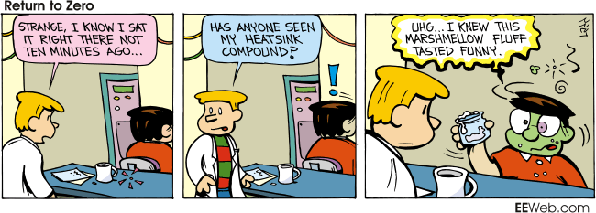
Safety Comic Strip Assignment
Create a comic strip about some aspect of safety include the problem and how to respond or treat the emergency
Must be minimum 6 boxes
Must be in color
Possible topics include:
Environmental emergencies
Severe thunderstorms
Hurricanes
Tornados, Earthquakes, Blizzards, , Shelter in place- what does it mean and how and when do you do it
Basic Safety: fire extinguishers, falls around the house, electrical cords, etc

Slide 15
