Slide 1
Overcoming the Pressure

Slide 2
WRITING PROMPT:
Explain your ideal/ dream date that you could go on?

Slide 3
Red Flags
Read to class pg. 182-184

Slide 4
6 guidelines to Intelligent Dating
Pg. 188

Slide 5
I Can’s:
I can explain what it means to “SET it, SAY it, and SHOW it” to help overcome pressure.
I can identify and list my own set of sexual boundaries as one way of overcoming peer pressure.

Slide 6
Media and Sex
Think of some popular TV shows that you watch or have seen in the past…
How much is sex talked about or viewed?
What consequences have been shown or mentioned in relation to sex?
Do these situation involve teenagers?

Slide 7
What message does the media send young people about sex?
How does peer pressure contribute to being sexually active?
Why are setting sexual boundaries important in a relationship?
Boundaries make sure you stay in control of physical feelings AND boundaries before marriage help teach self-control even AFTER marriage!

Slide 8
Media Pressure
What have we already discussed this year about media pressures?
Definition of ‘beauty’
Casual sex and song lyrics
Teen Magazine Pressure
What have we already discussed this year about pressures from certain forms of media like teen magazines?
What is REAL, what is not?

Slide 9
The Porn Trap
Pornography usually starts with casual __________
After a while you _______ get a thrill from something that was once exciting
2
3
4
1
DON’T
CURIOUSITY
You get addicted & it now
___________ your thoughts & life
You want something _______ explicit to get back to earlier levels of excitement
CONTROLS
MORE

Slide 10
Did you know?
Average age of first exposure to porn…
Average age of first exposure to Internet porn…
Percent of 8-16 year olds who have viewed porn online…
Boys: 11 Girls: 13
11
90%

Slide 11
Overcoming Pressure:
Establish boundaries
SET IT:
SAY IT:
SHOW IT:
Give a VERBAL response
Be ASSERTIVE

Slide 12
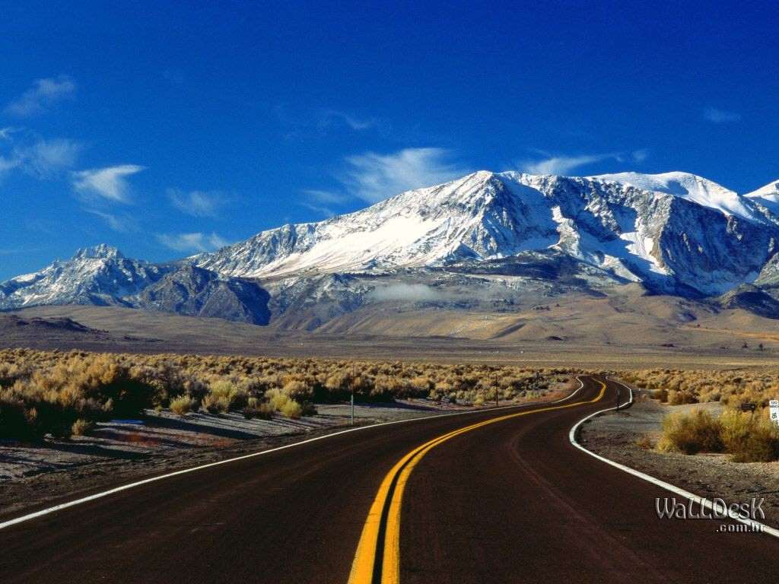
What’s the purpose in having a line down the center of this road?

Slide 13
IT’S A BOUNDARY:
Boundaries can give us freedom in our personal lives
They can give us security as long as we operate within them

Slide 14
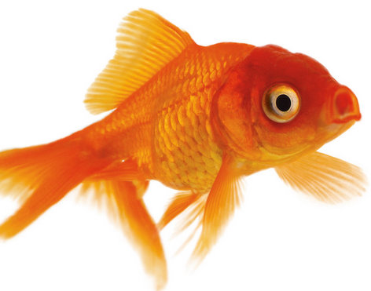
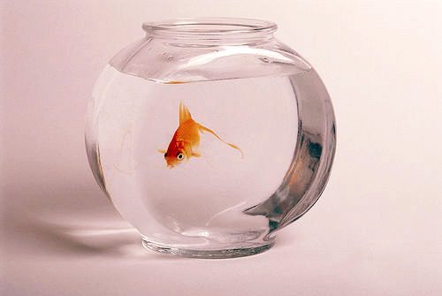
George the Goldfish

Slide 15
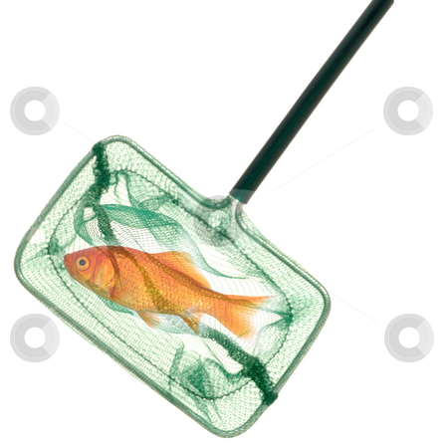
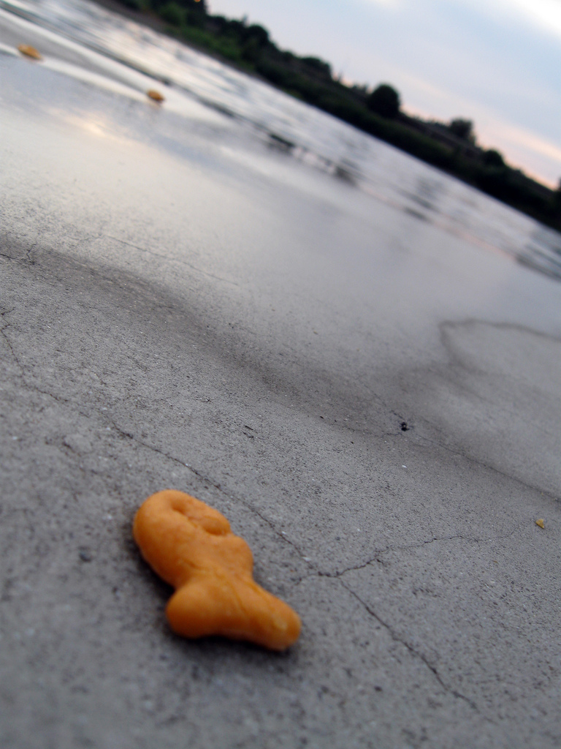
George the Goldfish
What do you think happened?
Rather than a limitation, his fishbowl provided a boundary that let him be truly free!

Slide 16
Sexual Progression
Sexual arousal is _________________:
It takes more sexual activity each time to back to the same level of excitement.
Unless sexual boundaries are established, the likely end-result of sexual activity is
______________________________
Sexual activity does ___________ form a foundation for healthy relationships!
PROGRESSIVE
SEXUAL INTERCOURSE
NOT

Slide 17
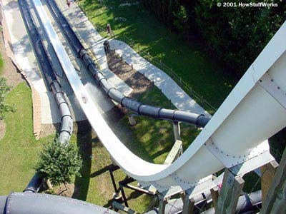
Sexual Progression
Holding hands
Kissing
Touching
“Other stuff”
Sex

Slide 18
SET IT
Avoid situations where you will be alone and___________________
Avoid certain ________________ where activities are too out of control
Never take off _________
easily persuaded
places/situations
clothes
Research says that nearly 70% of teens
have their first sexual experience in one of their own houses or at a friend’s
when no one is at home.

Slide 19
SAY IT
Pressure can often come from a single “line:” an insincere statement said to get you to do something that you don’t want to do.
When you hear one of these lines, you can respond with a “linebacker.”
Linebacker: a short response that CLEARLY states your values…and it can even be funny!
WHAT WILL YOU SAY?

Slide 20
SHOW IT
What is self discipline?
What self discipline steps will you need to take to help you reach your goals?
Make a list of various areas of your life that could benefit from self-discipline (time, financial management, relationships, etc.)
How does self-discipline apply to sexual boundaries? What would help you practice self-discipline in this area?
A personal decision to do (or NOT to do) something in order to reach a goal

