Slide 1
Metabolism

Slide 2
Metabolism
Metabolism is the process by which your body converts what you eat and drink into energy.
“Caloric need” - calories your body needs each day to maintain weight

Slide 3
BMR Basal Metabolic Rate
The amount of calories your body burns while at rest.
OR
The number of calories your body would burn if you stayed in bed all day.

Slide 4
Increase Your Metabolism
Build muscle!
Muscle cells use more energy when in “idle” than fat cells do, that way you are burning more calories when you aren’t exercising
Exercise more!
Do something fun, increase your fitness, and lose weight all at the same time

Slide 5
Obesity
Having a BMI of greater than
30 kg/m ² (Weight in Kilograms / Surface Area in Square Meters)

Slide 6
Body Composition
What your body is made of
For example:
82 lbs Lean body mass (muscle, bone, organs)
+ 33 lbs Fat (body fat, cell membranes, brain)
115 lbs Total Body Weight
Notes:
Composed of: blood, cardiovascular system, organs, skin, brain, fat. And bones

Slide 7
Body Composition
This is often recorded as a percentage
82 lbs Lean body mass (muscle, bone, organs)
+ 33 lbs Fat (body fat, cell membranes, brain)
115 lbs Total Body Weight
33/115 = 28% body fat

Slide 8
Body Composition
Body Percent Fat is often inaccurate
It is difficult to measure
Very athletic and very skinny people are even harder to measure
Sometimes, you’ll hear about an athlete who says they have 2% body fat, or something like that
That is IMPOSSIBLE. It is not good for your health if:
Men – body fat gets below 5%
Women- body fat gets below 12%

Slide 9
BMI Body Mass Index
A number based on your HEIGHT and WEIGHT
BMI=kg/m²
Adults are categorized by their BMI
<20 Underweight
20-24.9 Healthy Weight
25-29.9 Overweight
30+ Obese

Slide 10
BMI Body Mass Index
A number based on your HEIGHT and WEIGHT
BMI=kg/m²
Adolescents are categorized by their percentile
<5th Underweight
5th—85th Healthy Weight
85th—95th Overweight
>95th Obese

Slide 11
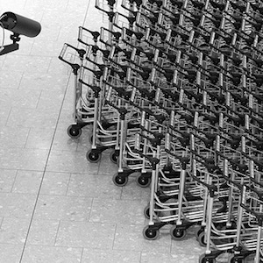
Why is BMI used?
It is easy to standardize
The only information need is a person Weight and Height
Can survey the health of the entire country with only 2 pieces of data (weight and weight)

Slide 13
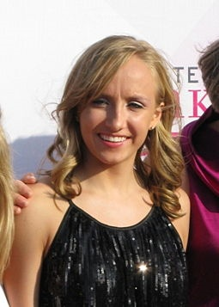
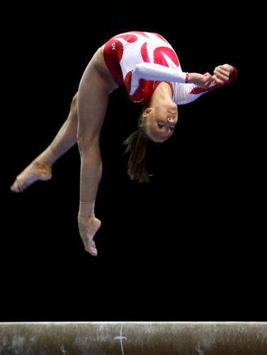
BMI Body Mass Index
5’2” and 99 lbs = BMI of 18.1 kg/m²
Nastia Luikin—Gymnast

Slide 14
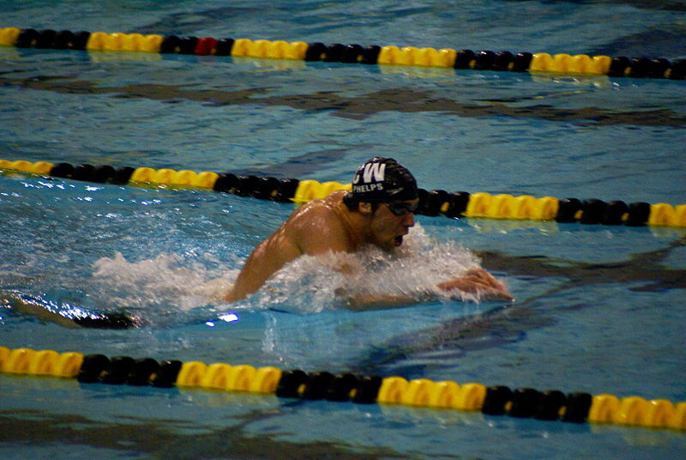
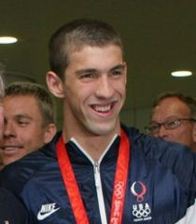
BMI Body Mass Index
6’4” and 195 lbs = BMI of 24 kg/m²
Michael Phelps—Swimmer

Slide 15
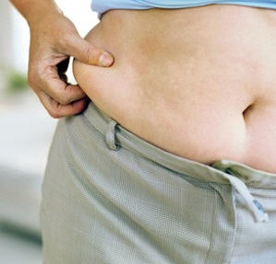
BMI Body Mass Index
5’10” and 195 lbs = BMI of 28 kg/m²

Slide 16
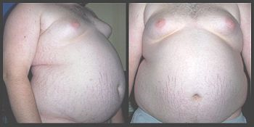
BMI Body Mass Index
5’10” and 322 lbs = BMI of 46 kg/m²

Slide 17
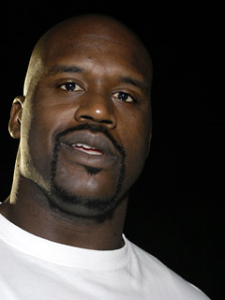
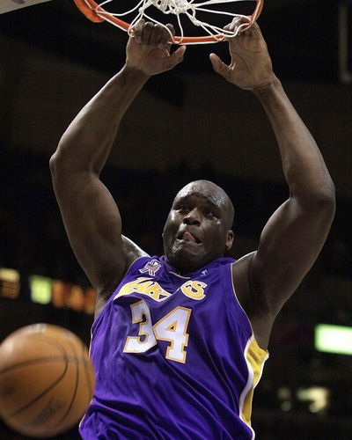
BMI Body Mass Index
7’1” and 325 lbs = BMI of 31.6 kg/m²
Shaq—Basketball Player

Slide 18
What is missing in BMI calculation?
Age
Race
Gender
Body Composition

Slide 19
Summary: BMI is a screening tool
It is a good first step in determining the overall health of a person
If you do have a high BMI, see it as a cue to take a thorough look at your lifestyle.
You may need to include you Dr. to check your overall health.

Slide 20
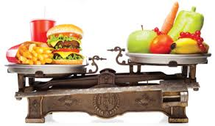
Causes of Obesity
Diet
Sedentary Lifestyle
Genetics

Slide 21
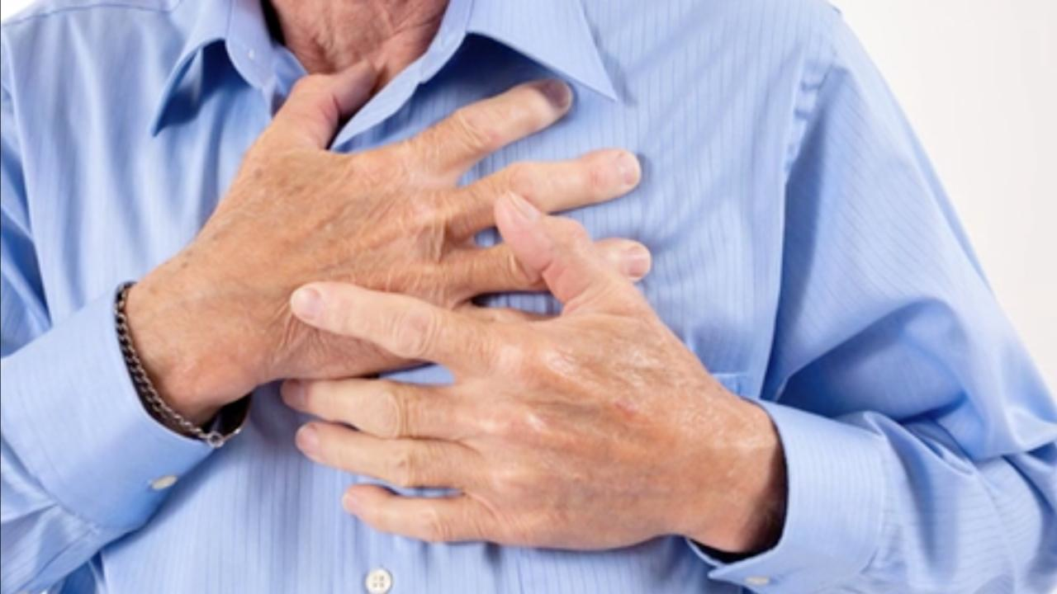
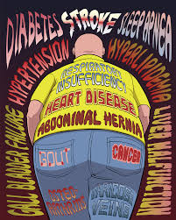
Why does Obesity Matter?
Heart Disease
Cancer
Type II Diabetes
Arthritis
Sleep Apnea
Depression
Gall Stones
Notes:
Risks of Obesity

Slide 22
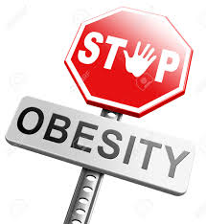
How Dangerous is Obesity?
With a BMI of 32, your risk of dying at any given time DOUBLES
Obesity on average shortens your life by 6-7 years
Severe obesity on average shortens your life by 20 years

Slide 23
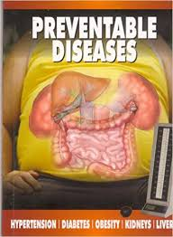
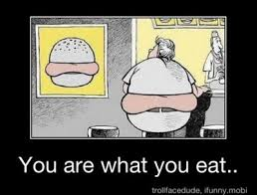
Prevalence of Obesity
32% of Americans are obese
The obesity rate has doubled since 1980
Obesity is possibly the leading preventable cause of death in America

Slide 24
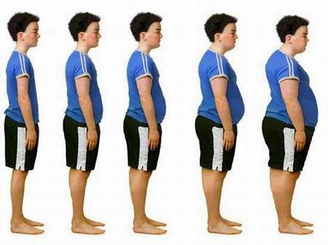
Childhood Obesity
Obesity isn’t just for old people anymore

Slide 25
16-20% of Kids in the US are Obese

Slide 26
Childhood obesity has dangerous long- and short-term health consequences

Slide 27
Lots of Factors are Being Blamed
Video games
Cultural changes
Higher consumption of junk food
Removing PE from schools
The internet
Fewer sit-down meals with the family
Cable and satellite TV
Smart phones
Poverty
Public transportation
More families owning multiple cars
Obese parents making it easier for their kids to be obese
Teenage dieting fads and eating disorders
Computers/Tablets
It’s probably a combination of them all

