Slide 1
Fitness for Life
Unit 4

Slide 2
Chapter 2

Slide 3
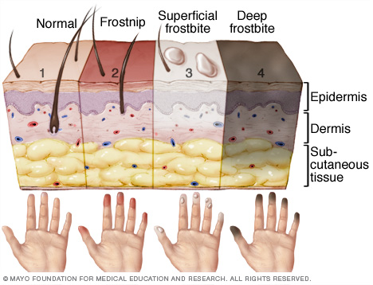
Hypothermia vs. Frostbite
Symptoms of Frostbite:
1. Skin becomes white or grayish yellow and looks glossy
2. Pain is sometimes felt early, but subsides later (often feeling is lost and no pain is felt)
3. Blisters may appear
4. The affected area feels intensely cold and numb

Slide 4
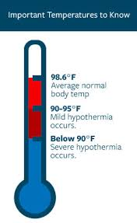
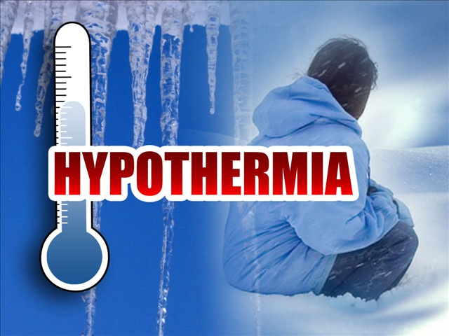
Hypothermia vs. Frostbite
Symptoms of Hypothermia:
1. Numbness
2. Shivering
3. Low body temperature
4. Confusion

Slide 5
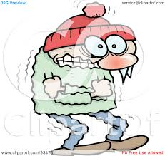
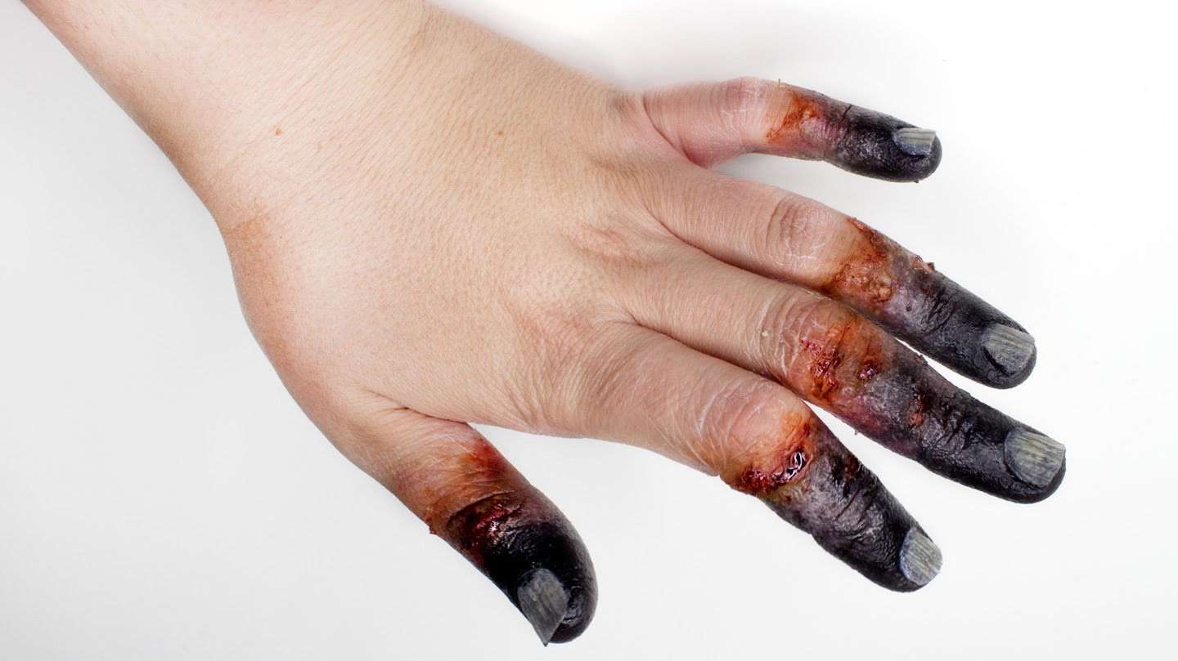
Hypothermia vs. Frostbite
Causes:
Hypothermia:
Excessively low body temperature that can result from extreme cold
Frostbite:
Skin exposed to ice or snow for extended period of time causing tissue to freeze

Slide 6
FROST BITE CLIP
Notes:
http://www.wingclips.com/movie-clips/mr-deeds/frostbite

Slide 7
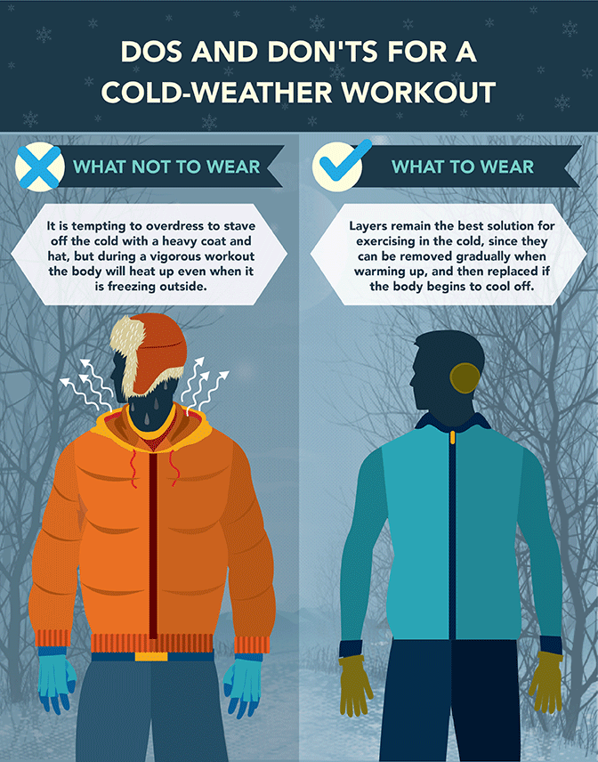
Exercising in Cold vs. Hot Weather
Precautions:
Cold:
1. Avoid extreme
cold and wind
2. Dress properly
3. Avoid exercising
in icy or cold, wet
weather

Slide 8
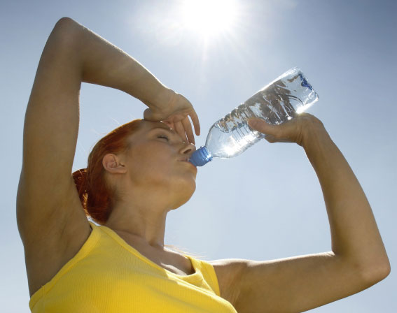
Exercising in Cold vs. Hot Weather
Precautions:
Hot:
1. Begin gradually
2. Drink water
3. Wear proper clothing
4. Rest frequently
5. Avoid extreme heat and humidity
6. Get out of the heat and cool the body when finished or if you start to overheat

Slide 9
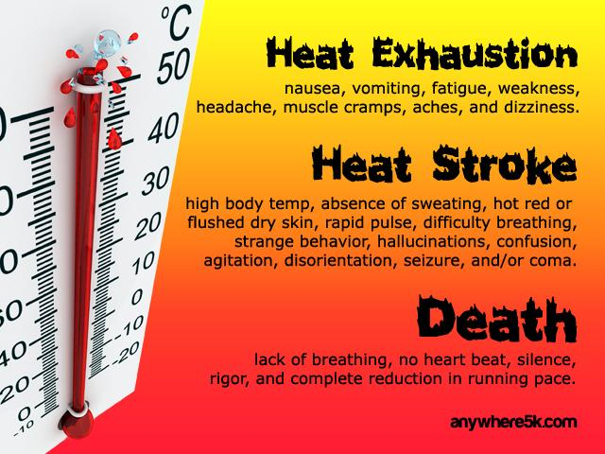
Notes:
END HERE!! Activity Tennis

Slide 10
Structure of the Body
Joint: point on the body where two bones come together. Joints are held together by muscles, ligaments and tendons.
Ligament: tough tissues that hold bones together at the joint
Tendon: tough tissues that connect muscle to bone

Slide 11
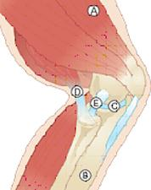
Diagram of the Knee
A. Muscle
B. Bone
C. Cartilage
D. Tendon
E. Ligament

Slide 12
Injuries Associated with Exercise
Types
Overuse injuries: Invisible damage to the body resulting from repeating a movement
Examples: stress fracture, shin splints, tendonitis
Side Stitch: in the side of the lower abdomen that people often experience in sports, especially running activities

Slide 13
Injury Prevention and Treatment
Injury Prevention:
Warm-up: activities done to get the body ready for exercise. Allows body to adapt to new stress being placed upon it.
Cool-down: easy activity used to calm the body down after exercise. Allows the body to return to normal temperature and heart rate.
Treatment:
R.I.C.E. : used when treating minor injuries
R: Rest
I: Ice
C: Compression
E: Elevation
Notes:
Rest stop using it for a day or two
Ice- 20-30 minutes 3 times a day
Compression- wrap it with a stretch bandage
Elevation- keep the injured area above the head

Slide 14
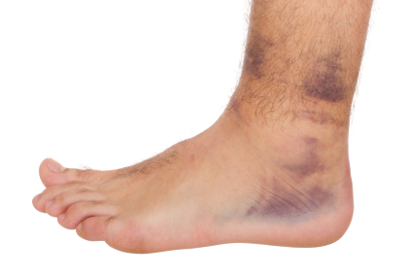
R.I.C.E. for a sprained ankle
Rest: stay off completely until you can walk with no limp
Ice: for the first 3 days and after activity as needed
Compression: as long as there is swelling use an ace wrap to reduce swelling
Elevation: level or above for 72 hours
Notes:
Activity: Cycling

Slide 15
Chapter 3

Slide 16
Back Problems
80 % of all adults in the United States will experience back pain.
Backache is considered a hypokinetic condition.
Back conditions:
Lordosis
Kyphosis
Ptosis
Scoliosis

Slide 17
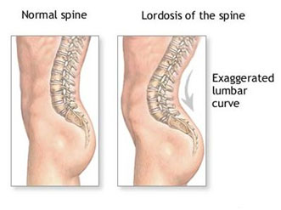
Back Conditions
Lordosis:
Too much arch in the lower back
Most common back condition with teens

Slide 18
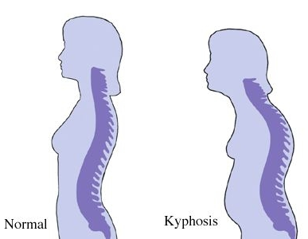
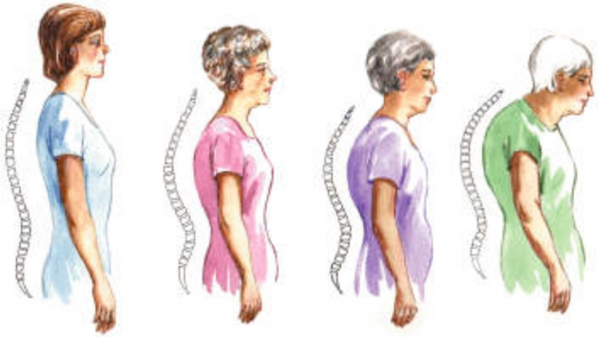
Back Conditions
Kyphosis:
Rounded back and shoulders

Slide 19
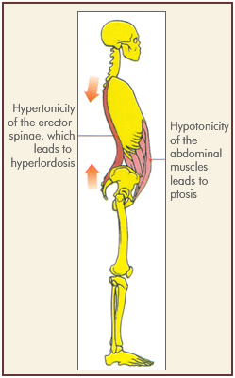
Back Conditions
Ptosis:
Protruding abdomen

Slide 20
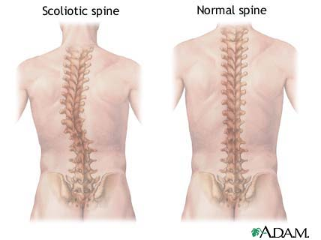
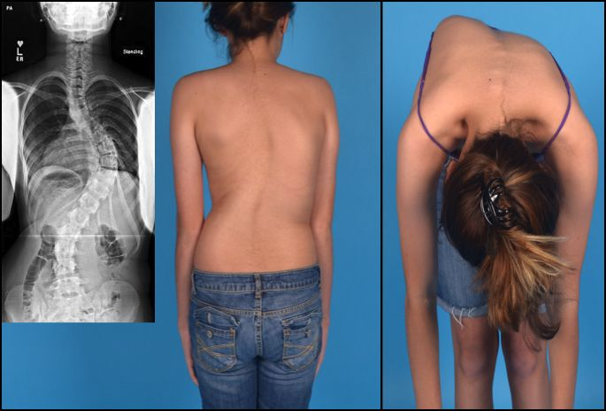
Back Conditions
Scoliosis:
Curvature of the spine

Slide 21
Ways to Prevent Back Problems
Posture:
3 ways posture helps you:
1. look good
2. prevent back problems
3. work and play more efficiently
Strength training
Increasing muscle strength in the back will help keep spine aligned
Notes:
Workouts: Strength Training to improve back /Core Synergistics

Slide 22
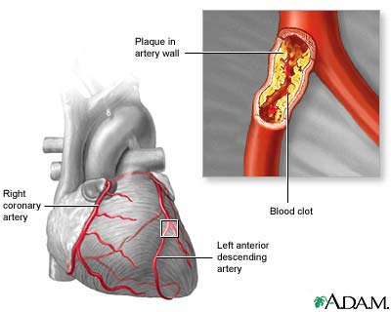
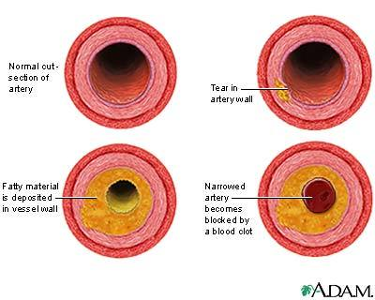
More Hypokinetic Conditions
Conditions that affect the heart:
Atherosclerosis: clogging of the arteries caused by the building up of fat and cholesterol inside the inner walls of the arteries.
Heart Attack: occurs when the blood supply into or within the heart is drastically reduced or cut off. This is caused often by atherosclerosis.

Slide 23
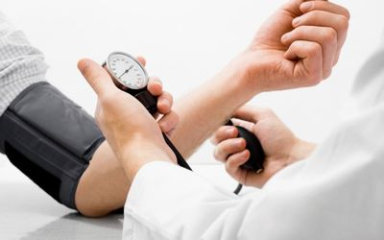
More Hypokinetic Conditions
Blood pressure: the force of blood against your artery walls. Normal range 120/80.
Hypertension: high blood pressure that is consistently beyond the regular healthy range

Slide 24
More Hypokinetic Conditions
Obesity: condition where a person has a high level of percent body fat that is onset by inactivity or other biological factors.
Diabetes: When a person cannot regulate their levels of sugar in the blood.
Type II diabetes used to be called adult onset diabetes, but now it affects many teens and children that do not regulate their body weight properly.
Stroke: oxygen in the blood supply to the brain is severely reduced or cut off.

Slide 25
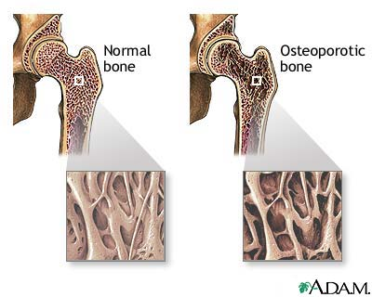
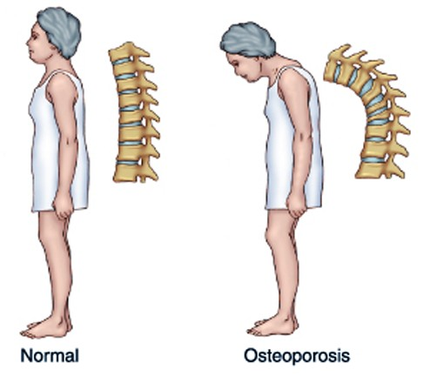
More Hypokinetic Conditions
Cancer: the second leading cause of death in the United States.
Osteoporosis: structure of the bone deteriorates and the bones become brittle and weak
Notes:
Obesity on the rise- finish fast food workout

